Slide 1
Predicting Crash Severity of Chicago Streets
Hawraa Salami
SPRINGBOARD Capstone Project 1

Slide 2
2018 Chicago Crash Facts
Total Crashes | 98,859
Total Injuries | 24,400
Total Incapacitating Injuries | 2,609
Total Deaths | 132
What conditions lead to severe crashes?
Data-driven models aim to understand the severity of crashes.

Slide 3



How can the models help?
City of Chicago Car Manufacturer Insurance Companies
Develop better traffic
control policies
Incorporate more safety
features
Perform better risk
assessment

Slide 4
Chicago Crashes Dataset
The data is available from Chicago online portal*.
It contains information of Chicago crashes from 2015 to present.
Crash Location and Time | External Conditions | Crash Cause and Description
Crash hour, day, month Crash address | Weather & Lighting Conditions Road alignment, type and surface Speed Limit and Control Device | Primary Cause (driving behavior) Type of Collision Type of crash: Injury or No injury

Slide 5
Data Analysis Steps
Goal: Build a model that predicts the type of crash (Injury or No Injury)
Steps:
Data Wrangling
- Filled missing entries
- Removed irrelevant columns
Exploratory Analysis
- Explored crash features of Injury and No Injury crashes
- Explored the crashes on Chicago map
Model Building
- Train predictive model for crash severity

Slide 6
Exploratory Analysis
Data Visualization & Statistical Analysis

Slide 7
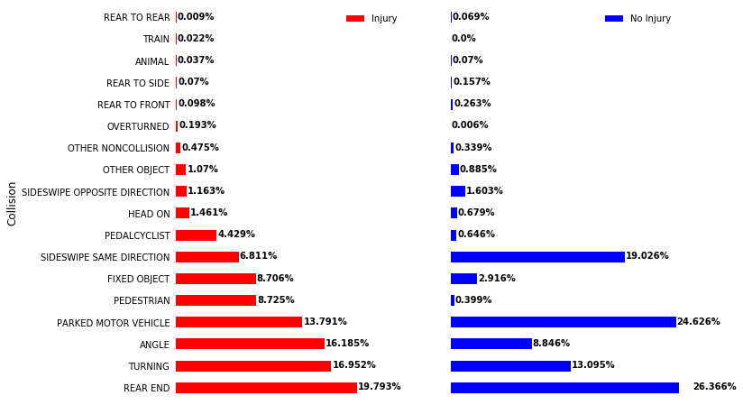
Collision Distribution for Each Crash Type

Slide 8
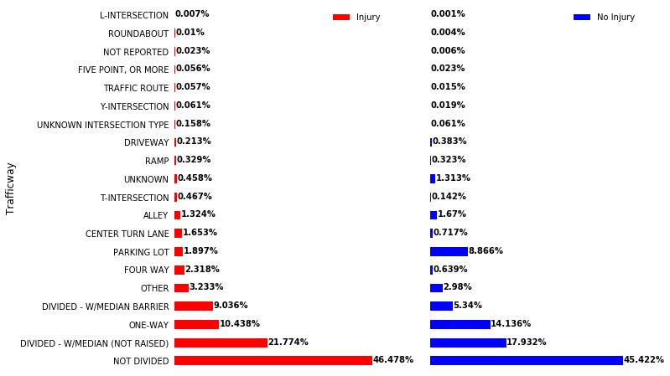
Trafficway Distribution for Each Crash Type

Slide 9
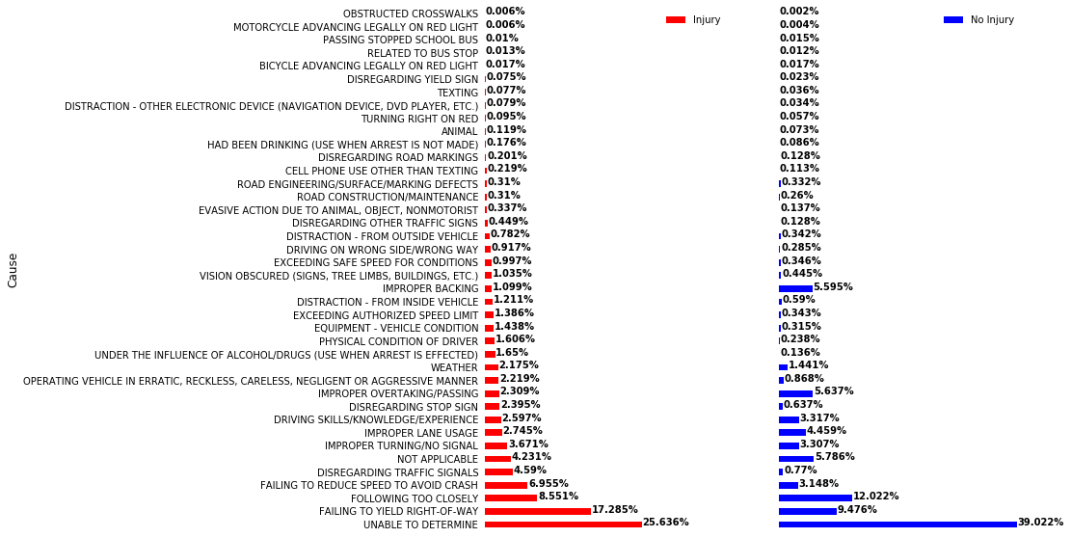
Driving Behavior for Each Crash Type

Slide 10
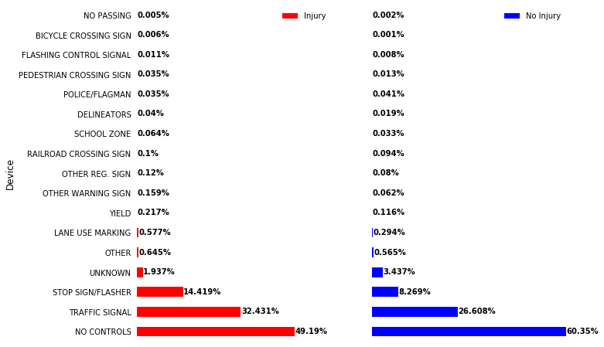
Control Device for Each Crash Type

Slide 11
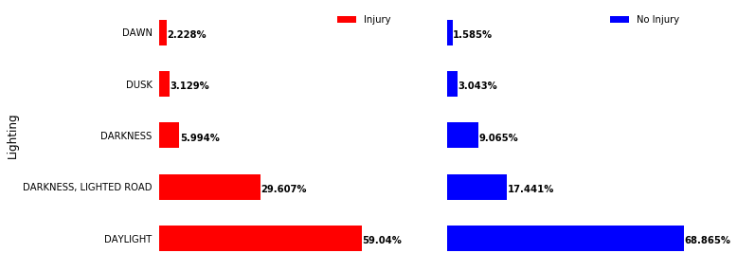
Lighting Conditions for Each Crash Type

Slide 12
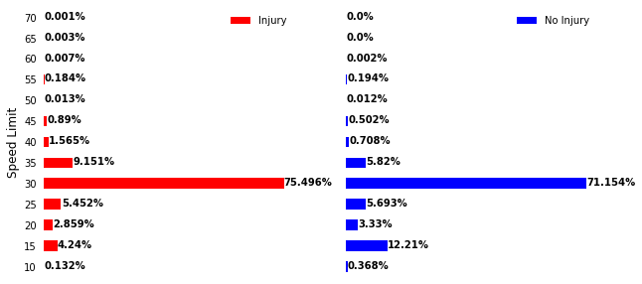
Speed Limit Distribution for Each Crash Type

Slide 13
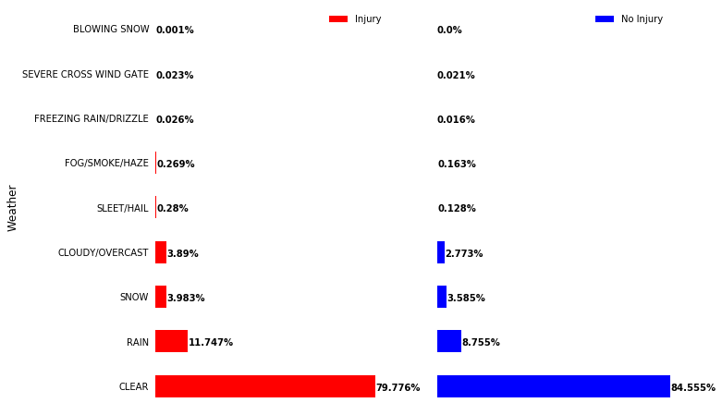
Weather Condition for Each Crash Type

Slide 14
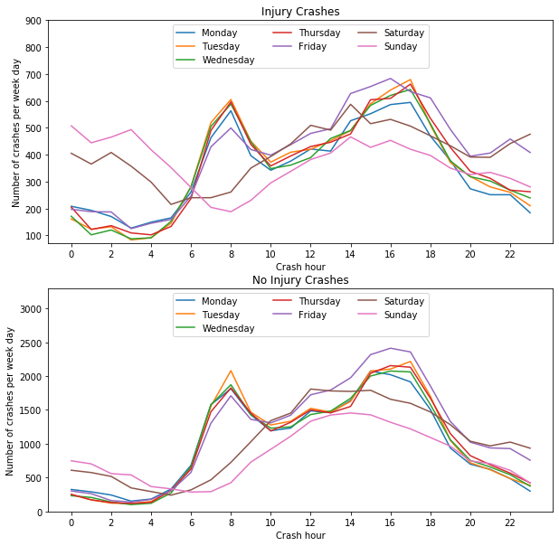
Number of Injury Crashes per Hour

Slide 15
Number of No Injury Crashes per Hour

Slide 16
Association Measure between Crash Features and Crash Type
Crash Feature | Cramer’s V Coefficient
Collision | 0.354896
Primary Cause (Driving Behavior) | 0.305708
Trafficway Type | 0.166856
Crash Hour | 0.140647
Lighting Conditions | 0.132704
Posted Speed Limit | 0.127492
Control Device | 0.121500
Road Surface Condition | 0.064132
Weather Condition | 0.057022
Road Alignment | 0.056438
Crash Day | 0.039466
Crash Month | 0.022364

Slide 17
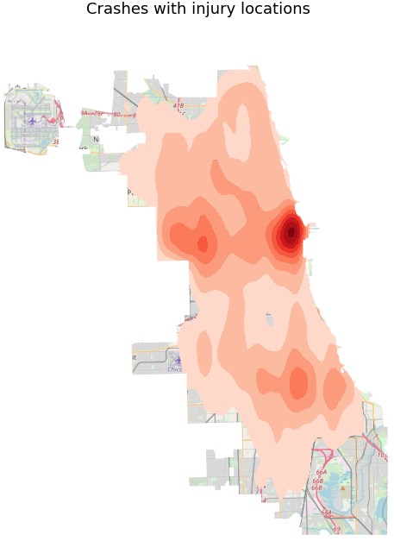
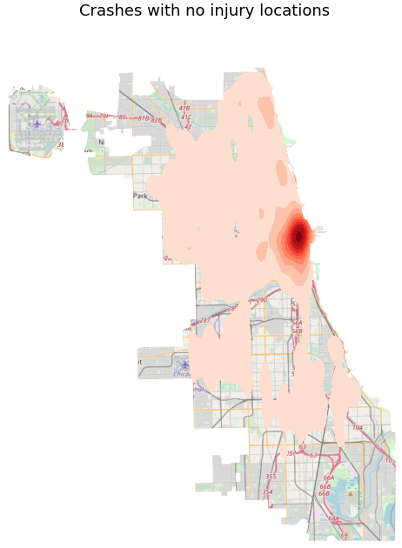
Kernel Density Estimation of Crashes’ Location

Slide 18
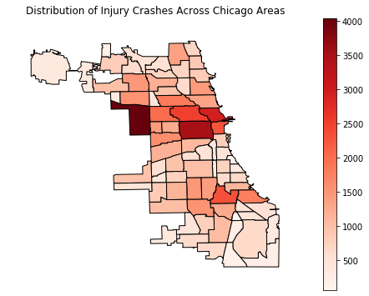
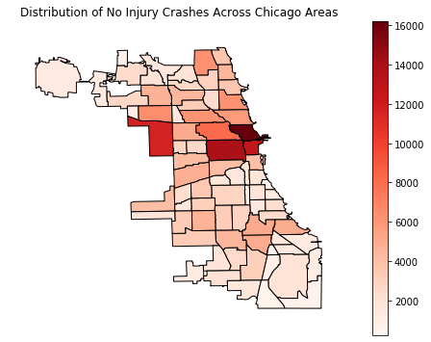
Crashes’ Distribution Across the Community Areas of Chicago

Slide 19
Key Findings
Driving behavior and type of collision showed strongest association with crash severity:
Example of such behaviors: disregarding traffic signal and stop sign, failing to reduce speed or not giving the right-of-way.
Example of collisions: angle, turning, collisions with pedestrians.

Slide 20
Key Findings
Remaining features showed less strong association with crash severity.
Crashes with Injury do not only happen at rush hours of the weekdays, but also at early hours of the weekend.
Injury Crashes are not only located in the central part of Chicago but also in the west side of the city.

Slide 21
Building the Predictive Model
In-Depth Analysis

Slide 22
Additional Preprocessing
Additional Preprocessing Steps:
Added one column “Area” to designate the Chicago area of the crash
Converted nominal categorical features into numerical entries:
Tried different encoding schemes (one hot, binary, leave-one-out)

Slide 23
Data Imbalances
No Injury crashes: 78% , Injury crashes: 22%
To address imbalances:
- Metrics used: precision, recall and F1-score
- Considered under-sampling of the majority class

Slide 24
Steps of Model Building
Split the data into training and testing sets:
Performed 5-fold cross validation on the training set:
Tested the final chosen model on the testing set:
80%
20%
5-fold cross validation
- train different combination of: encoding scheme and training model, with/out under-sampling
- select the final model using F1-score

Slide 25
Training Models
We tried various models and compared their performance:
Naïve Bayes
Logistic Regression
Linear SVM
Random Forest
Ada Boost
Gradient Boosting
Balanced Random Forest

Slide 26
Final Model and its Performance
Selected Final Model (trained after undersampling):
Gradient Boosting (parameters: n_estimators=600, max_depth=4)
+ Leave-one-out Encoding
Performance on the testing set:
Accuracy | 0.747
Precision | 0.697
Recall | 0.457
F1-Score | 0.552

Slide 27
Features’ Importance
Crash Feature | Importance
Collision | 0.418
Primary Cause (Driving Behavior) | 0.287
Trafficway Type | 0.071
Area | 0.054
Crash Hour | 0.042
Posted Speed Limit | 0.041
Lighting Conditions | 0.033
Control Device | 0.016
Crash Month | 0.0086
Crash Day | 0.0066
Road Alignment | 0.0062
Weather Condition | 0.0059
Road Surface Condition | 0.0058

Slide 28
Possible Future Works
Additional Work:
Incorporate more features related to driver and vehicle’s information
Consider stacking of the models
Account for location in terms of zip code instead of the code area
Perform street level analysis
Focus on crashes with injury and analyze the conditions of possible types of injuries (fatal, incapacitating and non-incapacitating)

Slide 29
Recommendations
Driving behavior: important feature in predicting severity of crashes especially at intersections
Efforts should be focused on:
Pushing drivers to drive recklessly
Keeping on educating drivers of defensive driving techniques
Helping drivers not loosing attention

